Slide 1


Machine Learning in Science: Encoding physical constraints & good development practices
Workshop, AMLD 2021
Materials at: https://github.com/hanveiga/amld-2021-repML
Organizers:
Maria Han Veiga (MIDAS)
Miles Timpe (UZH)

Slide 2
What is this workshop about?
Focus on relevant ML practices in academia / scientific context
ML is used as a tool to give us insights into problems, solve problems quicker, understanding things better
It is another tool, as numerical simulations (for example), are a tool to best understand science
As such, we need good practices and standards to use ML
Difference between ML in industry and in Science — we often have answers to the problems — we have constraints that must be fulfilled. Things which are obviously wrong — that traditional metrics do not measure.

Slide 3




Who are we
Maria Han Veiga
Postdoctoral Fellow Michigan Institute for Data Science University of Michigan
PhD, Mathematics (University of Zurich) MSc, Computational Science and Engineering (ETH Zurich) BSc, Mathematics (Imperial College of London)
Specialties: Computational Science and Mathematics
Me with my new car, trying to fit in the US
@hanveiga
mhanveig@umich.edu

Slide 4
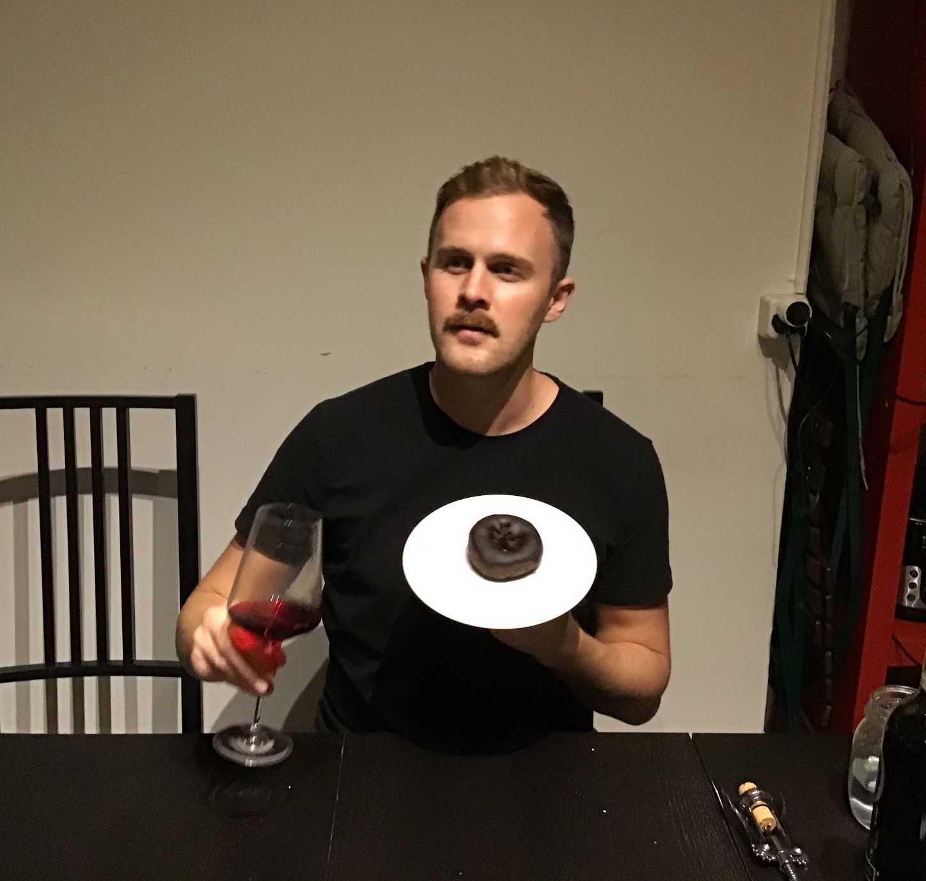
Who are we
Miles Timpe
Postdoctoral Researcher Institute for Computational Science University of Zurich
PhD, Theoretical Astrophysics & Cosmology (University of Zurich) MSc, Astrophysics (Erasmus Mundus Joint Master Program) BSc, Physics & Astronomy (University of Washington)
Specialties: Computational Astrophysics, Rocket Stuff
Too old / not cool like Maria
mtimpe@physik.uzh.ch

Slide 5
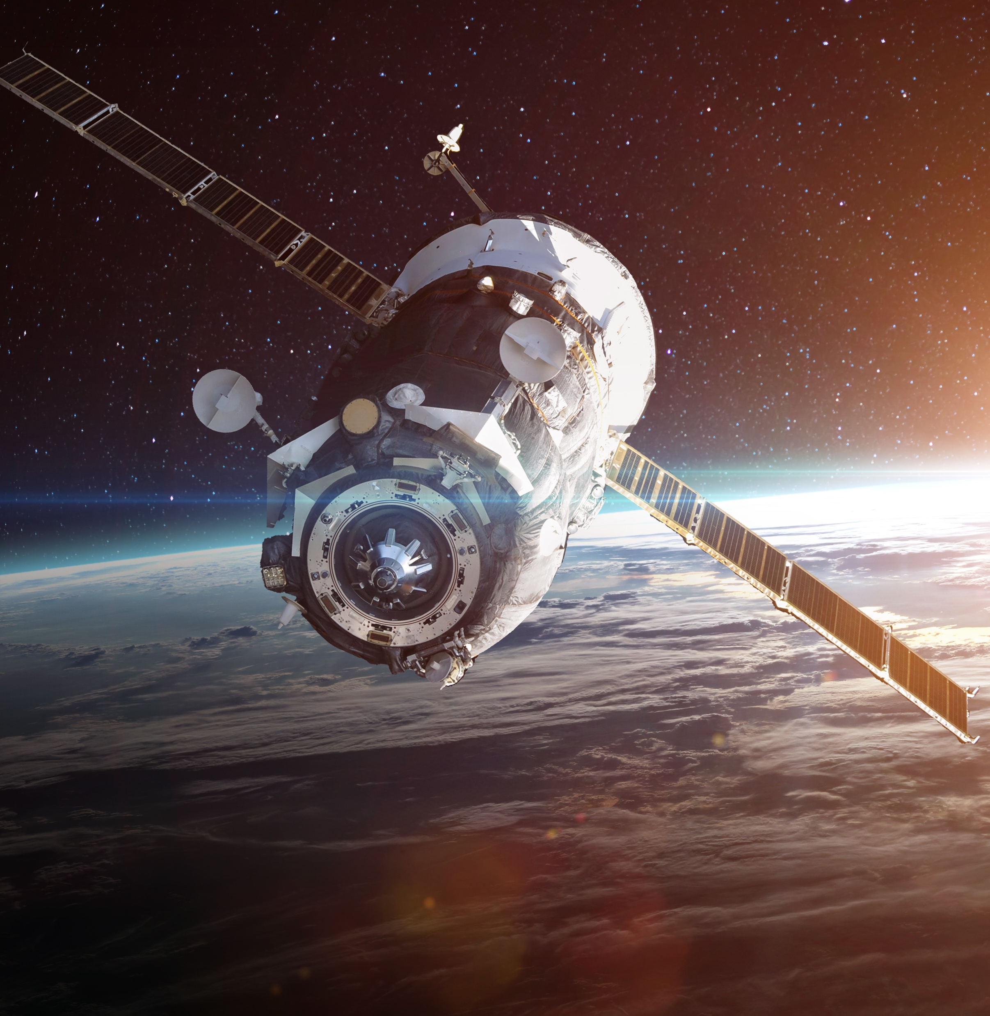

AI in the Space Sciences
Frontiers in Artificial Intelligence
Topic Editors
The space sciences encompass the scientific disciplines related to the exploration and study of space, as well as more Earth-oriented applications such as remote sensing and atmospheric monitoring. The use of artificial intelligence (AI) in the space sciences is rapidly expanding.
The massive amount of data now being delivered in real-time by Earth observation assets (e.g., the Copernicus sentinel network) and astronomical missions (e.g., Kepler Space Telescope) is providing exciting new datasets and has necessitated the adoption of novel machine learning techniques. Indeed, remote sensing is driving innovation in deep learning for large-scale image processing tasks, whereas in astrophysics AI is being used in a broad range of applications, including planet detection, galaxy classification, and cosmological modeling.
In order to highlight the uses of AI in space, this article collection welcomes contributions related to the use of AI in space or to study space. This article collection is a follow-on initiative of the "AI & Space" track, held at the AMLD2020 in Lausanne (25-29 Jan, 2020).
Maria Han Veiga University of Michigan, USA
Miles Timpe University of Zurich, Switzerland
For more information
ai@frontiersin.org
fron.tiers.in/rt/13513

Slide 6

Some general discussion …
An informal survey conducted at MIDAS, where 8 data scientists discussed current trends of ML in various fields of academia has yielded the following insights
There is no formal standard when it comes to publishing ML related material in various fields (e.g.: mathematics, psychology, physics, political science, economics).
In computer science there is some incentive to publish code/datasets (e.g.: paperswithcode / paperswithoutcode, as well as upon submission of materials in conferences / journals).
Although there is awareness of various tools to keep track of the development of code / data / models, there is no consensus or common practices in each field.
It falls upon the researcher to find ways to keep track of their pipelines. For example, excel files, annotated code, github, google spreadsheets to keep track of model changes / results, read me files to describe dataset/code.

Slide 7
Some general discussion …
After a project is concluded, typically the results are stored in hard drives, github (which is not always maintained), Dropbox type accounts, Cluster, publicly available data (academictorrents.com, dryad.com) or published along with the paper.
However, the consensus was that there was no good guide or principles for development of ML systems geared towards academic purposes.

Slide 8
Agenda
9:00 | 9:15 | Virtual coffee / Introduction (MT,MV)
9:15 | 9:30 | Virtual env set-up (MT)
9:30 | 10:00 | Intro to AEGIS + Basic Example (Notebook 1) (MT)
10:00 | 10:30 | Intro to rule based constraints (Notebook 3) (MT)
10:30 | 10:45 | Coffee break
10:45 | 11:15 | Reproducibility and Scientific Pipelines (MV)
11:15 | 12:00 | Reproducibility tools (Notebook 2) (MT)
12:00 | 14:00 | Lunch break
14:00 | 14:45 | Encoding physical constraints (MV)
14:45 | 15:00 | Coffee break
15:00 | 15:15 | Break
15:15 | 16:00 | Encoding physical constraints hands-on session (MV,MT)
16:00 | 17:00 | Free hacking / discussion
Materials at: https://github.com/hanveiga/amld-2021-repML
Notes:
Introduction — 15 minutes — general description, motivation, who are we, etc…
Scientific machine learning — what is it, what’s the point / Incorporating physics contraints — review, why do we do it, different ways to do it — 75 minutes
Break — 30 minutes
Reproducibility in ML — what are we talking about, reproducibility, research results, what is important, etc — 90 minutes
pipeline — different tools — 30 minutes
Presenting dataset 30minutes
Costumizing loss functions in Keras — 30 minutes
Using a established framework — 30 minutes
09:00 - 09:15 09:15 - 09:30 Virtual env set-up (MT) 09:30 - 10:00 Intro to AEGIS + Basic Example (Notebook 1) (MT) 10:00 - 10:30 Intro to rule based contraints (Notebook 3) (MT) 10:30 - 10:45 Coffee break 10:45 - 11:15 Reproducibility and Scientific Pipelines (MV) 11:15 - 12:00 Reproducibility tools (Notebook 2) (MT) 12:00 - 14:00 Lunch break 14:00 - 14:45 Encoding physical constraints (MV) 14:45 - 15:00 Coffee break 15:00 - 16:00 Encoding physical constraints hands-on session (MV,MT) 16:00 - 17:00 Free hacking / break-out rooms

